Slide 1
GenomePro 2.0 Team Members: Guido Ruiz & Mardoqueu Mesquita Product Owner: Michael Robinson Instructor: Masoud Sadjadi School of Computing and Information Sciences Florida International University
Senior Project Final Presentation Fall 2015
December 11, 2015
Notes:
Greet your audience, thank them for attending your presentation, introduce yourself, introduce your project, introduce your team members, and quickly indicate what each of you did in a high-level manner, and put more emphasis on your part/contribution.

Slide 2
Problem definition
Whole Project:
This project intended to create a framework designed to help Biomedical Researchers by offering specific tools and methods for genomic data processing.
These tools should handle extensively large genome data to ease tasks that is otherwise considered tedious and can take a very long time to be completed, such as using Microsoft Excel to process genome files.
Hence GenomePro aim to facilitate the use of these tools by creating a web application that offers portability and security.
My Part:
System Design
Front End Development
C Programs (File Validator, Unique Sequences, Repeated Sequences)
Verification (Automation via Selenium IDE)
Documentation
Notes:
Introduce the problem that the whole project tackles and stay focused on the parts that you have been working. Indicate if there is an existing previous system, enumerate its problems/limitations, etc.

Slide 3
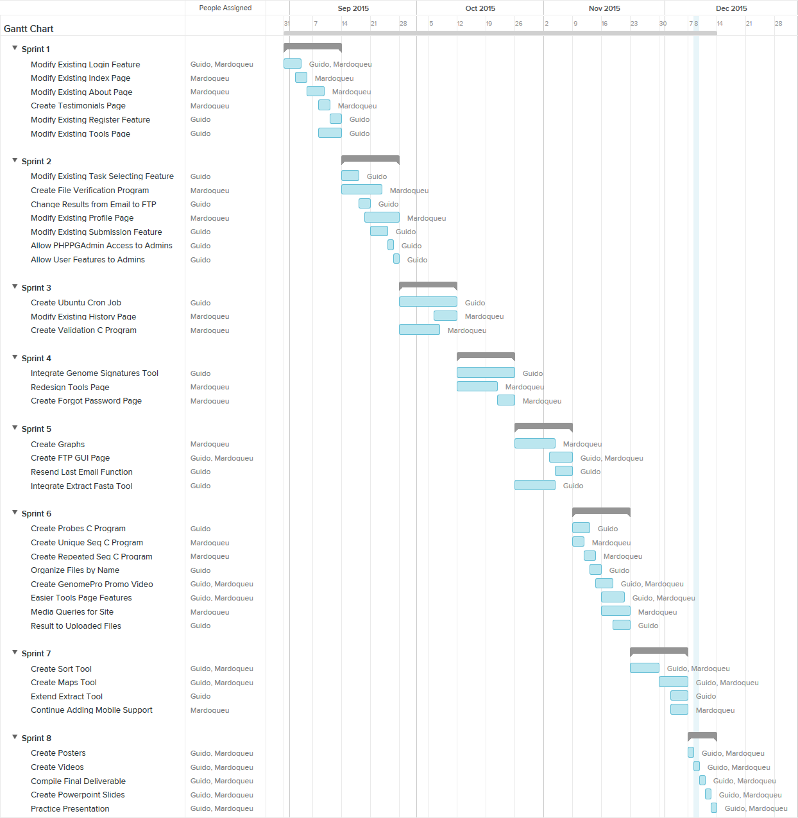
Gantt Chart
Notes:
Project Management (schedule for entire semester) (one slide; Gantt Chart).

Slide 4
User Stories
# 231 – Modify Existing Forgot Password Feature
# 232 – Modify Existing Register Page
# 233 – Modify Existing Login Feature
# 234 – Modify Existing Submission Feature
# 235 – Change results from Email to FTP
# 236 – Modify Existing Task Selecting Feature
# 237 – Modify Existing About Page
# 238 – Modify Existing Profile Page
# 239 – Modify Existing Home Page
# 243 – Modify Existing Tools Page
# 244 - Create File Verification Program
# 245 – Create FTP GUI Page
# 247 - Create Validation C Program
# 248 – Modify Existing History Page
# 249 – Integrate Genome Signatures
# 250 – Redesign Tools Page
# 251 – Create Forgot Password Functionality
# 253 – Integrate Fasta Sub-Sequence Tool
# 254 – Create Graphs
# 259 – Create Unique Sequences C Program
# 260 – Create Repeated Sequences Program
Notes:
4. Requirements:
4.1. User stories implemented (one or more slides).
4.2. UML use cases and the use case diagram for the implemented use cases (one or more slides).
4.3. UML sequence diagrams for the implemented use cases.

Slide 5
User Stories
# 262 – Easier Tools Page Features
# 263 – Result to Upload Files
# 264 – Media Queries For Website
# 265 – Create GenomePro Promo Video
# 266 – Create Sort Tool
# 267 – Create Maps Tool
# 268 – Extend Extract Tool
# 269 – Continue Adding Mobile Support
Notes:
4. Requirements:
4.1. User stories implemented (one or more slides).
4.2. UML use cases and the use case diagram for the implemented use cases (one or more slides).
4.3. UML sequence diagrams for the implemented use cases.

Slide 6
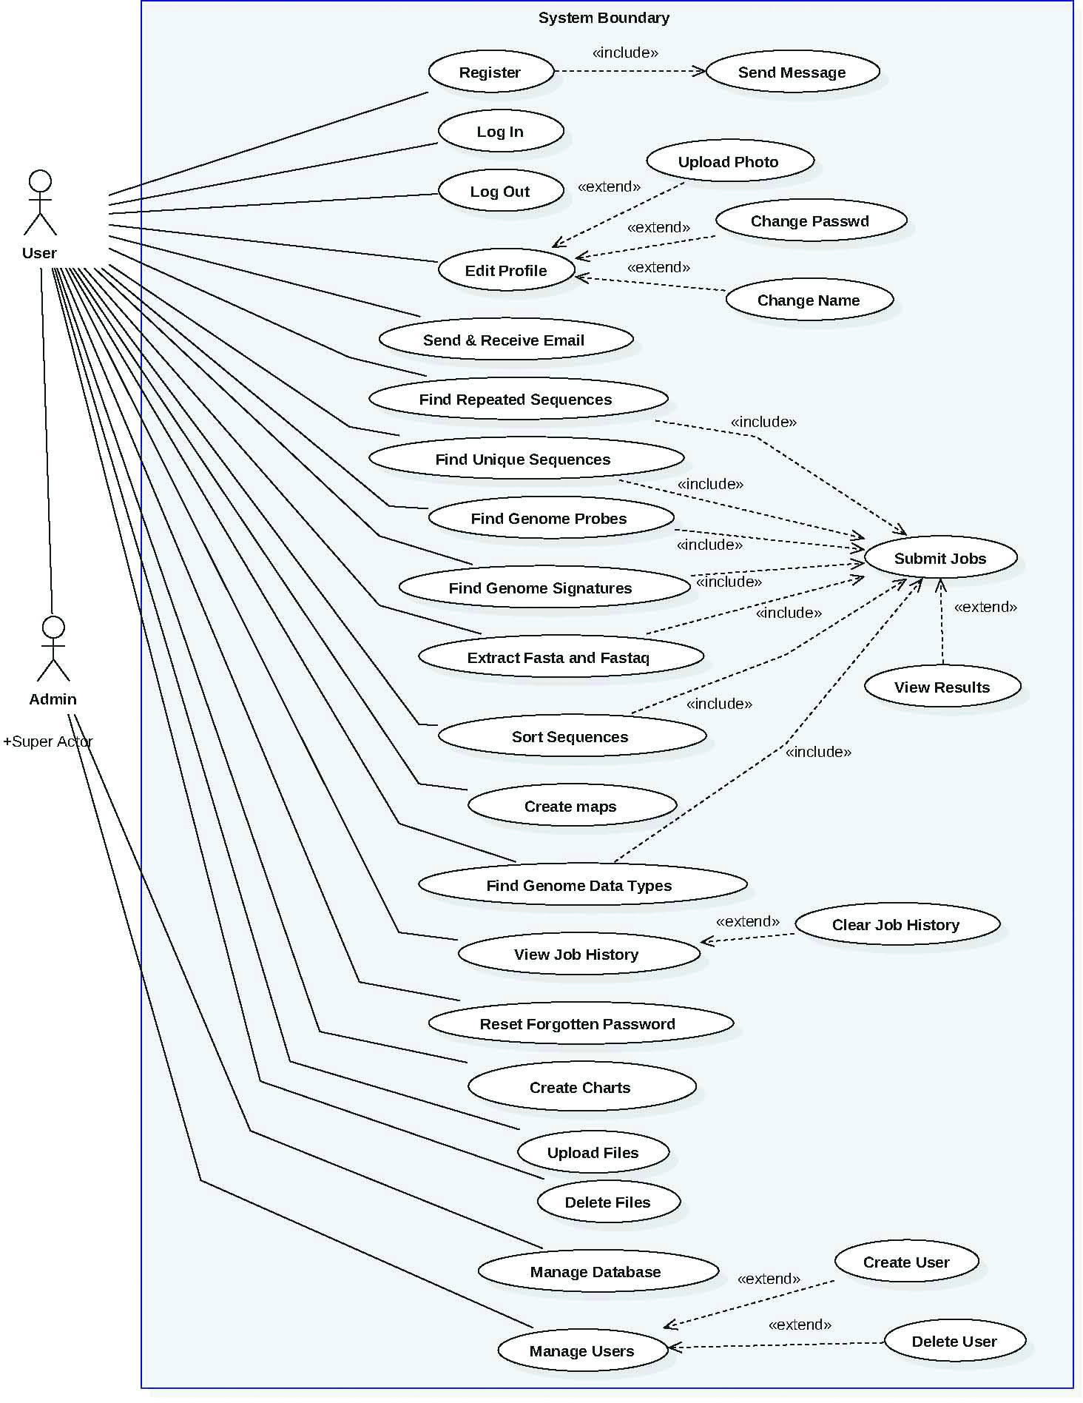
Use Cases
Total of 29 use cases
Admin actor is a super of User
Notes:
4. Requirements:
4.1. User stories implemented (one or more slides).
4.2. UML use cases and the use case diagram for the implemented use cases (one or more slides).
4.3. UML sequence diagrams for the implemented use cases.

Slide 7
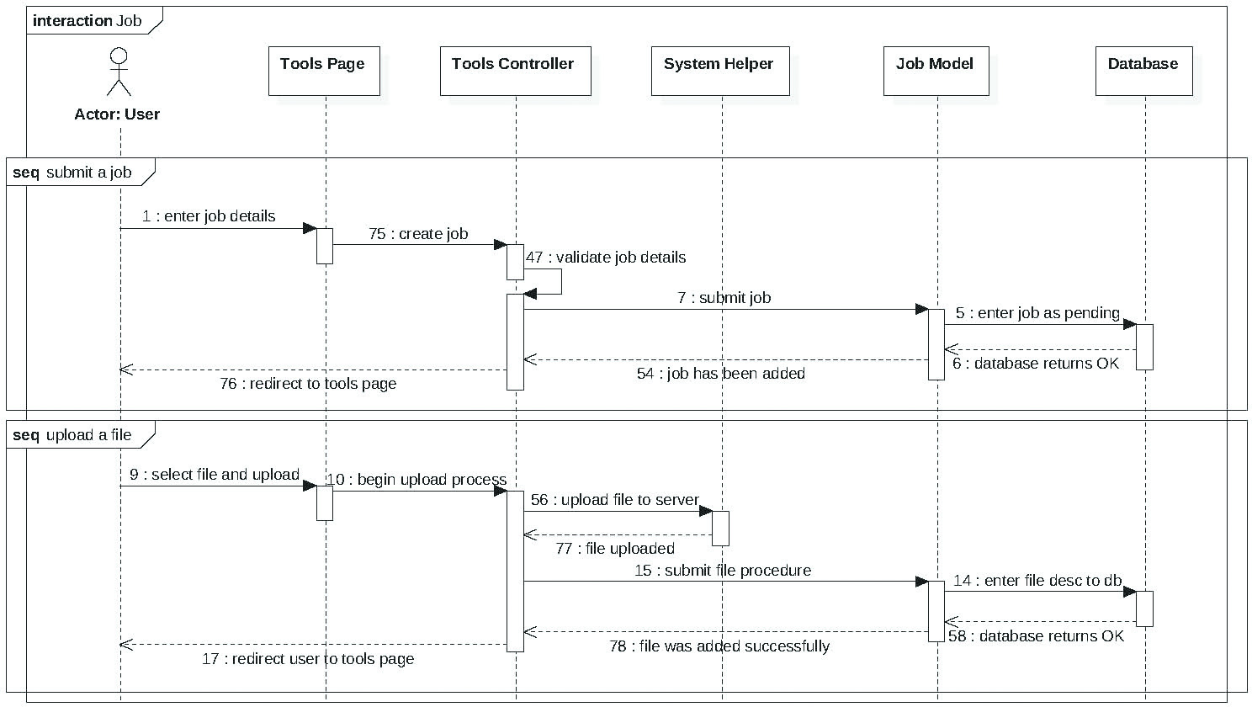
Sequence Diagrams - Jobs
Notes:
4. Requirements:
4.1. User stories implemented (one or more slides).
4.2. UML use cases and the use case diagram for the implemented use cases (one or more slides).
4.3. UML sequence diagrams for the implemented use cases.

Slide 8
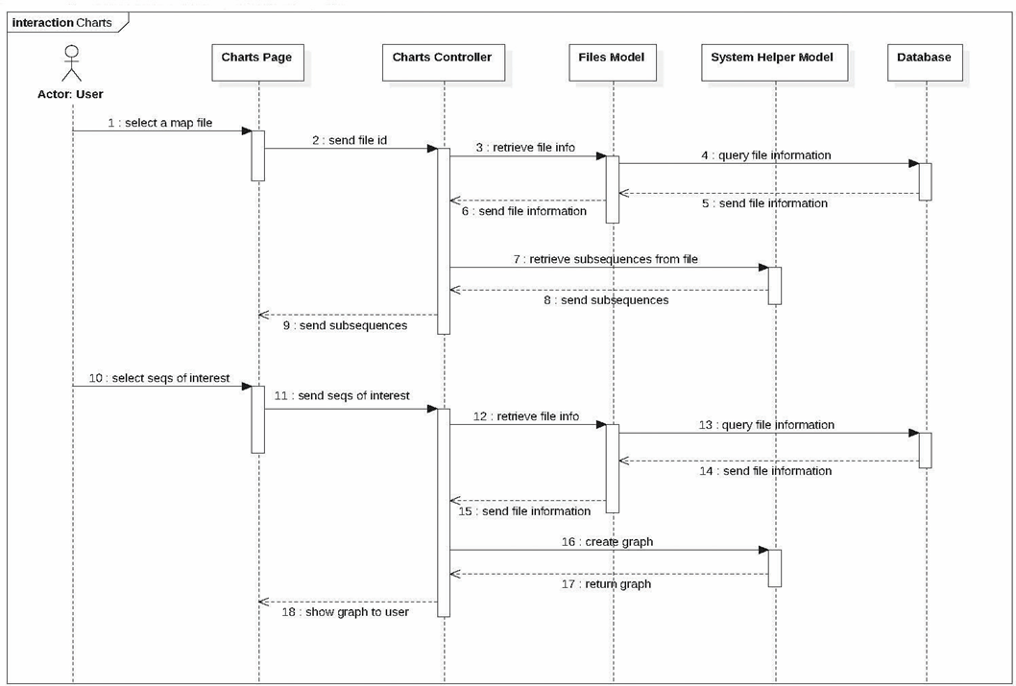
Sequence Diagrams – Create Charts
Notes:
4. Requirements:
4.1. User stories implemented (one or more slides).
4.2. UML use cases and the use case diagram for the implemented use cases (one or more slides).
4.3. UML sequence diagrams for the implemented use cases.

Slide 9
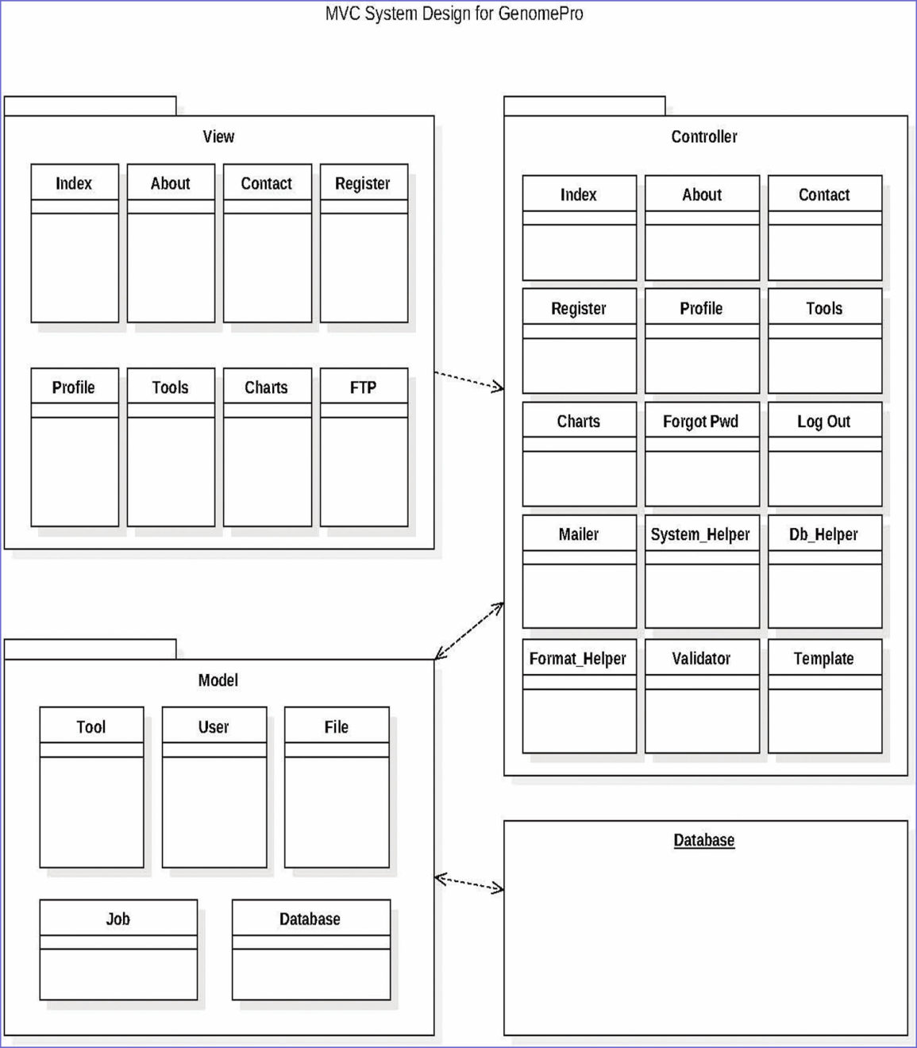
System Design and Decomposition
The system implementation was designed under the Model – View – Controller (MVC) as the primary architectural pattern.
This architecture is appropriate for our system and we are glad to work with it. MVC emphasizes modularity and scalability thus allowing us to separate the application’s data, logic, and user interface
Under the MVC architecture, the system is split into 3 packages: the UI package, the Controller package, and the Data package

Slide 10

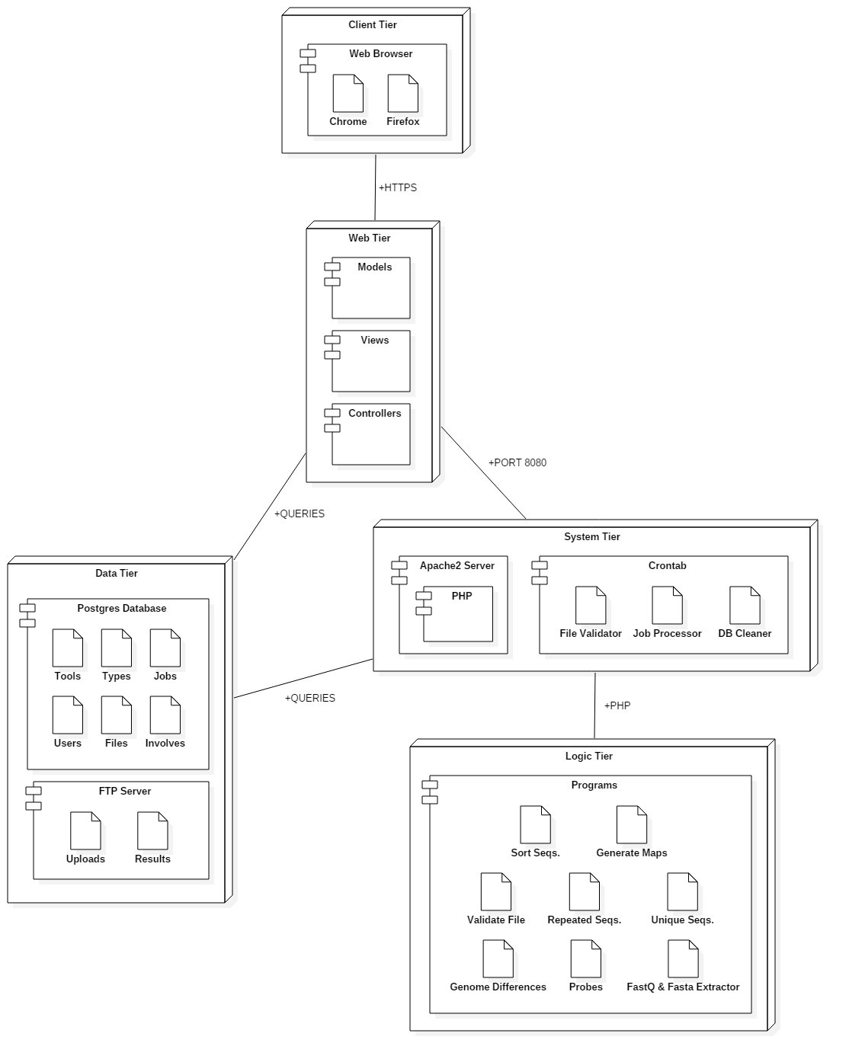
Deployment Diagram
GenomePro 2.0 is split into 5 tiers:
Client
Web
System
Logic
Data

Slide 11
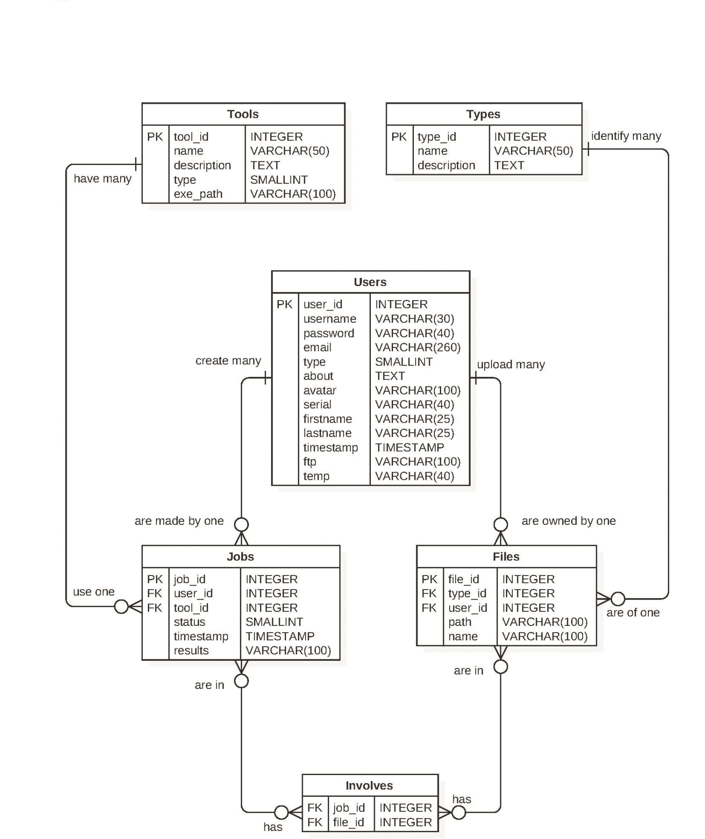
Database Modeling
Because GenomePro 2.0 offers several tools to Biomedical Researchers, and each tool handles files in a different manner, the need to build the database around the tools was evident.
There are currently 6 tables. Using joins, multiple information can be obtained from each user, ranging from personal information to job submission or file related information.
GenomePro 2.0 uses Postgres as its database and the schema is in third normal form.

Slide 12
Security and Privacy
Prepared Statements
Database attacks are avoided using SQL prepared statements to verify any queries processed by Postgres.
All queries run through a database library that handles row retrieval and execution with the use of protected variables.
Automatic Logout
After a long period of inactivity, no actions are approved by the web service and the user is sent back to the login page
Pages there can only be accessed after logging in redirect guest users to the home page, preventing the use of GenomePro tools without account verification.
FTP Password Verification
Users are asked for their login information when accessing their FTP, even if they are logged into the site, to add another layer of security.
Notes:
5. System design:
5.1. System decomposition; identify the architecture patterns used (one slide).
5.2. System deployment – h/w and s/w requirements (one slide).
5.3. Persistent data design (one slide).
5.4. Security/Privacy (one slide).

Slide 13
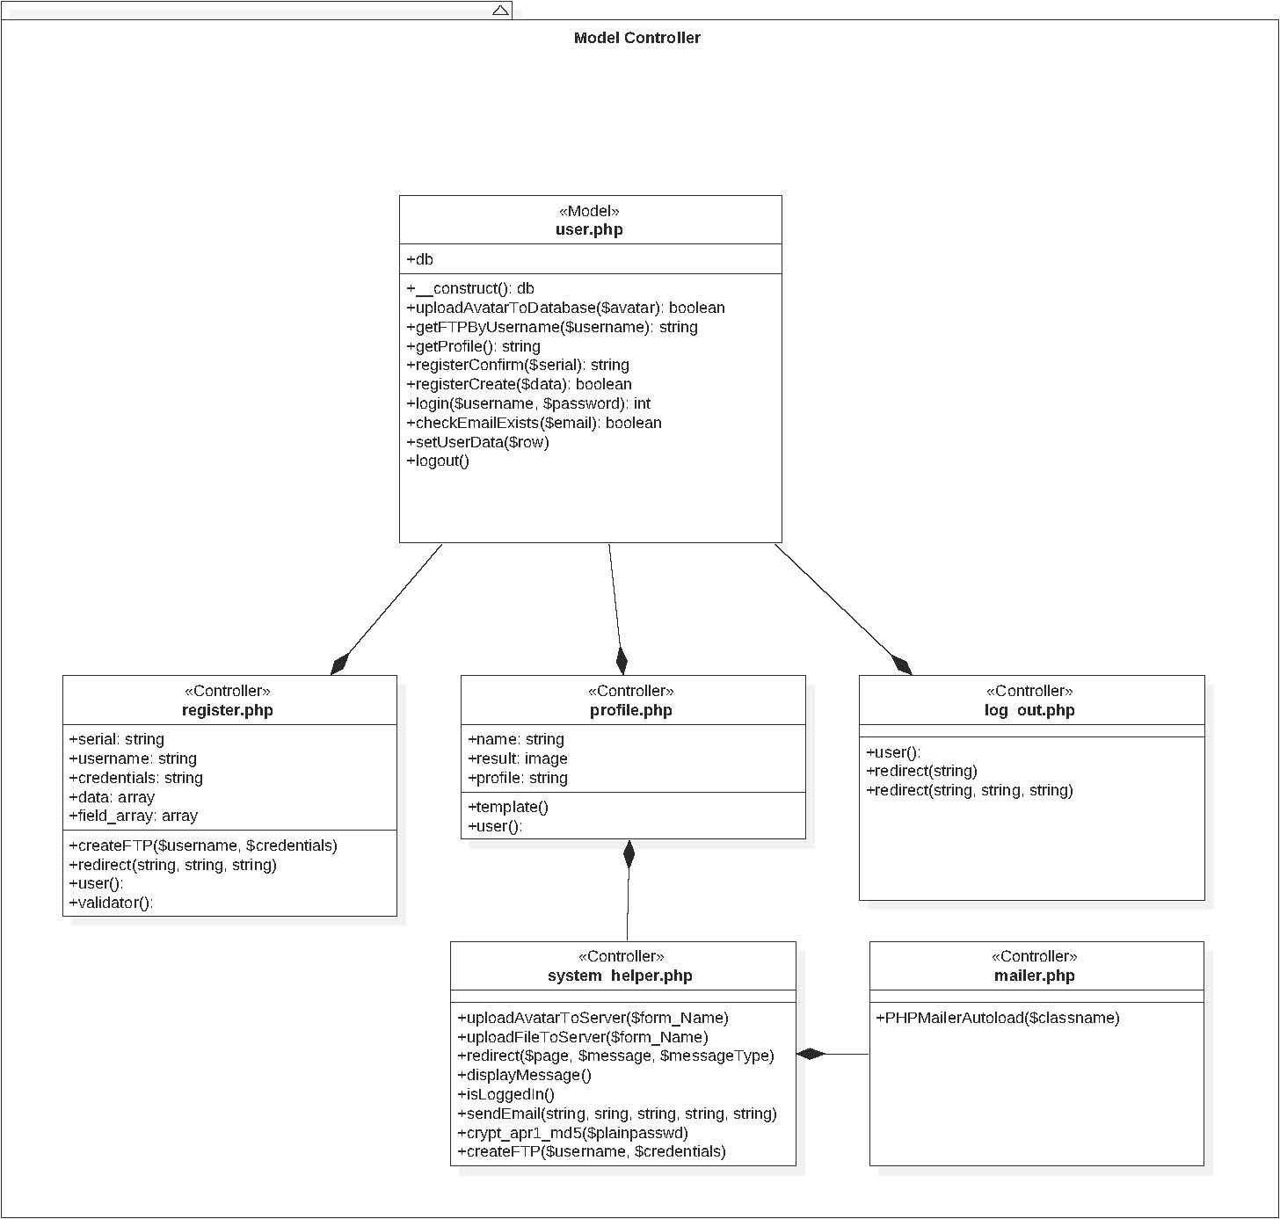
Model - Controller
The User Model is Used by the register, profile, mailer, system helper and logout controllers use cases.
The user model in charge of any queries done mainly on the user table within the database
It stores functions that are essential for use cases such as longing in, changing email, etc.

Slide 14
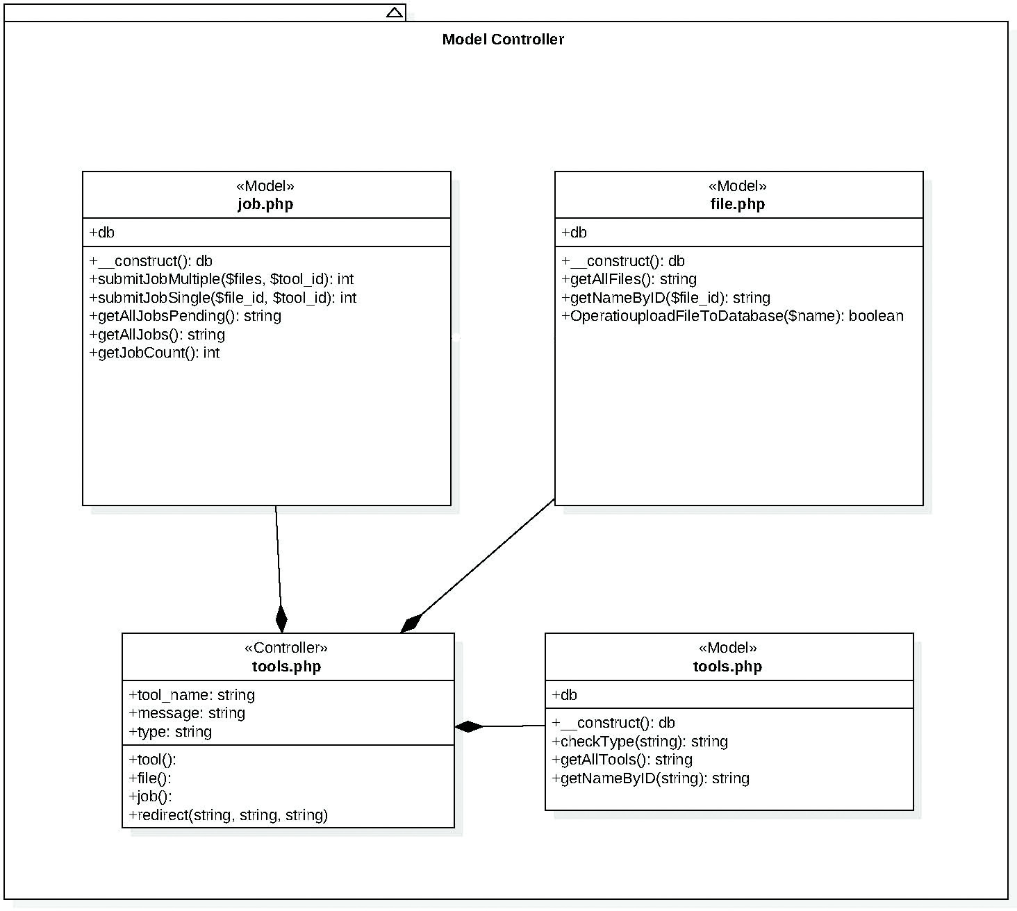
Model - Controller
The Job Model is in charge of any queries related to submitting and/or retrieving job information.
It works closely with the file model which assist in retrieving files necessary to submit a job.
The tools controller speaks directly with the file and job model and acts as a messenger to the tools model.

Slide 15
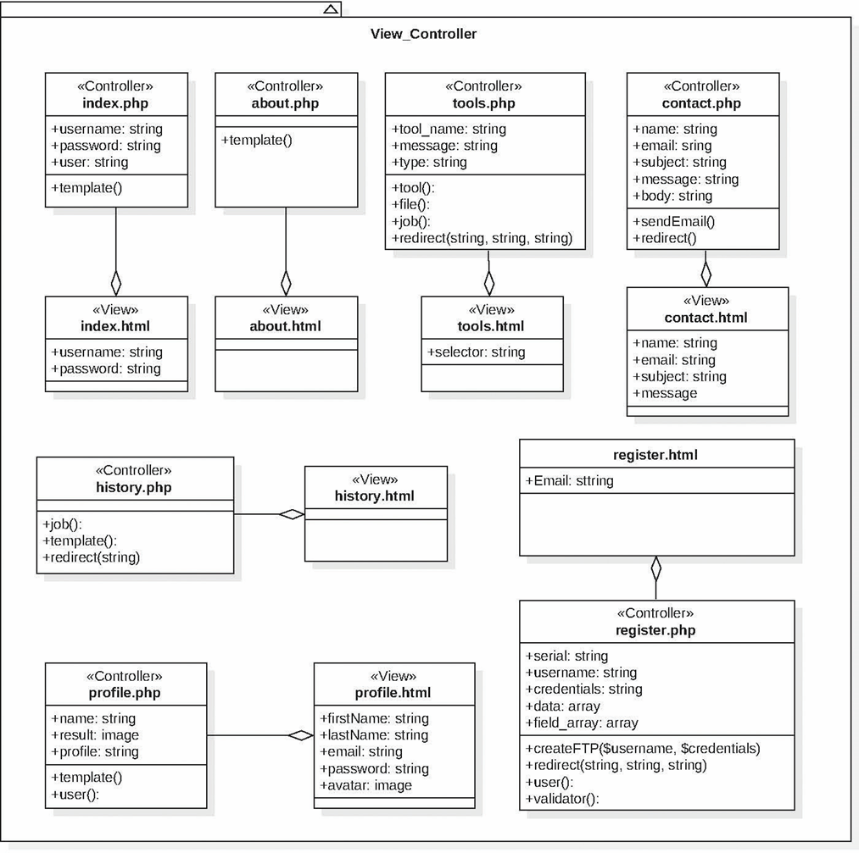
View - Controller
The controllers pass information to the views with the use of variables and templating.
There is no direct communication between the view and the model since the controller first collects variables from the model and then passes them to the view.

Slide 16
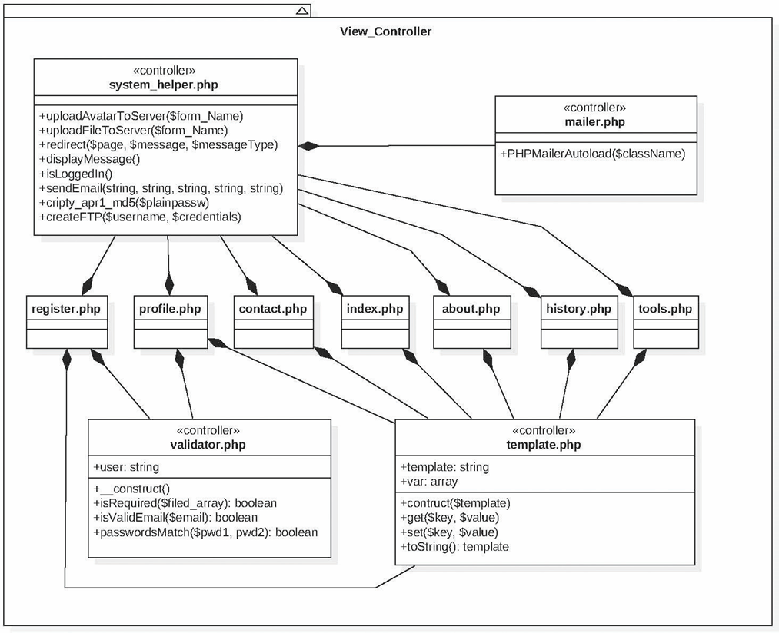
View - Controller
The System helper contains very helpful functions that each controller uses in some way or another.
Because of this, the system helper is a pseudo model, yet still acts like a controller because it lacks communications to the database.
Notice that the template controller works very similar as it is what the controllers use to communicate with the views.

Slide 17
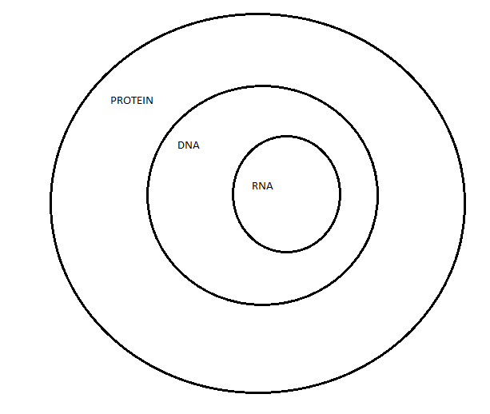
Genome Data Types
Array Truth Values
BASEs (ACGD Etc.)
Read genome file: Each line character by character
Read each character and set boolArray element to true
For i from 0 to size of boolArray
If element of boolArray is true
allFalse is false
Stop
If allFase is not true
If any element of boolArray is in protein set
typeArray[2] is true (file is protein)
Else if all elements of boolArray from DNA set is false
typeArray[1] is true (file is RNA)
Else
typeArray[0] is true (file is DNA)
Notes:
6. Detailed design:
6.1. Minimal class diagram. Identify the design patterns used (one or more slides).
6.2. State machine for the main control object or the most important object of the implemented uses cases (one or more slides).
6.3. Main algorithm used related to an implemented use case described above (one or more slides).

Slide 18
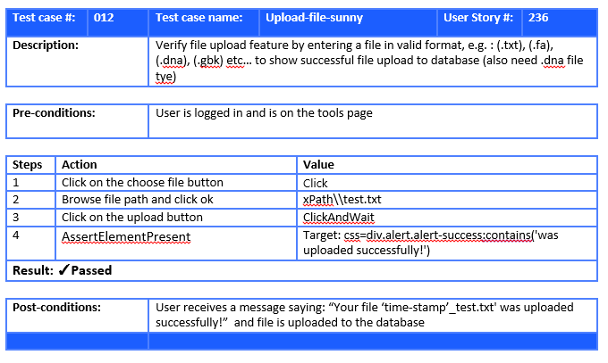
Test Cases
Notes:
7. Test Suites and Test Cases (one sunny day and one rainy day) for the use case represented in part (5) above (2 slides).
7.1 One sunny day and one rainy day for the implemented use cases (one or more slides).
7.2 Automated test scripts for the implemented use cases (one or more slides).

Slide 19
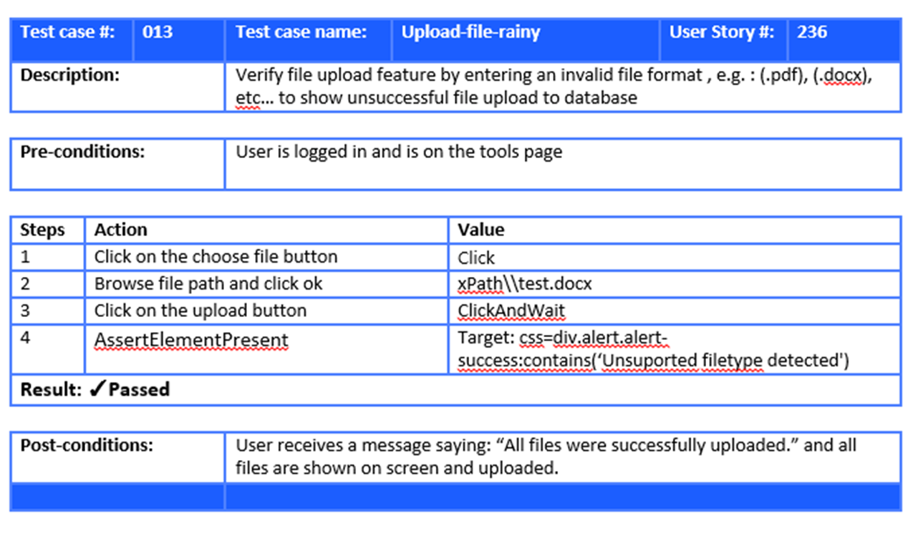
Test Cases
Notes:
7. Test Suites and Test Cases (one sunny day and one rainy day) for the use case represented in part (5) above (2 slides).
7.1 One sunny day and one rainy day for the implemented use cases (one or more slides).
7.2 Automated test scripts for the implemented use cases (one or more slides).

Slide 20
Summary
GenomePro 2.0 conveys a well-structured programming framework via a web service that is designed to deliver efficient and robust analysis tools for next generations genome sequencers.These tools were created to provide Biomedical Researchers the power to process very extensively large genome files.
The learning opportunity during the project and the collaborative work with Guido Ruiz, my team member, was tremendously appreciated. While there is more room for improvement to the site, I believe that I have successfully accomplished what was assigned to me during the project.
Mardoqueu Mesquita
mmesq001@fiu.edu
Thank you for your attention!
Notes:
Summarize your contribution
Include your contact information
Ask if anyone has any questions for you.
Thank your audience

